Slide 1
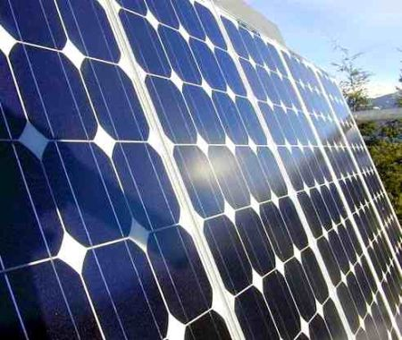
Carron Hall Solar Energy Project A model of solar energy application in Jamaica
Presented by:
Dr. Michael Case PhD, PE
Adjunct Faculty, UTECH
Renewable Energy Systems Consultant

Slide 2
A Call to Action
April 2009 – Call from Bobby Montague MP West St. Mary with some needs:
Community of about 2000 citizens
No running water in community
Water Spring about 200 feet below road level
2 x 3000 gallon concrete ground tanks erected nearby
Need economical efficient system to pump water and alleviate citizen’s trek down the treacherous slopes
Expenses to be Bourne by local gov’t and St. Mary Parish Council

Slide 3
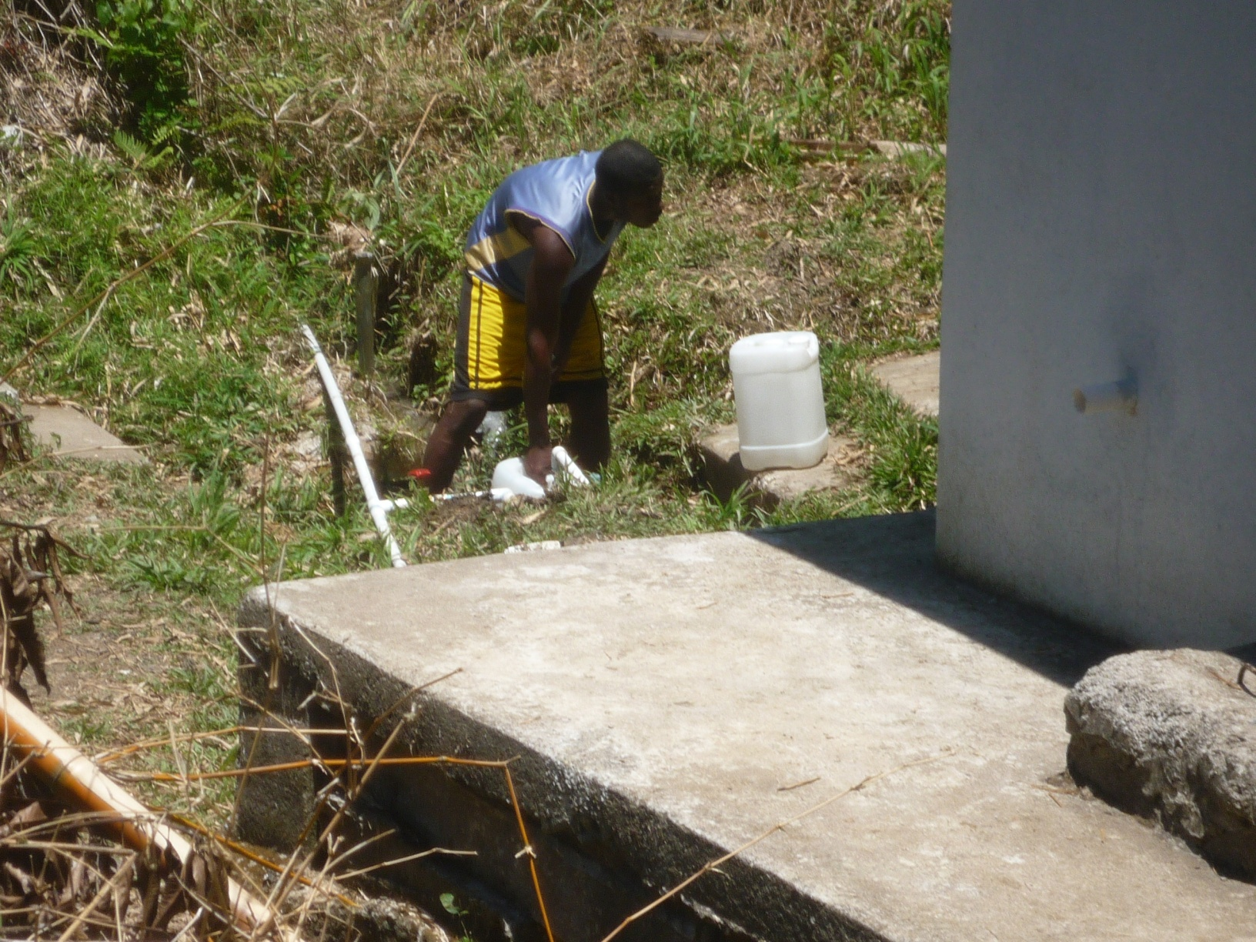
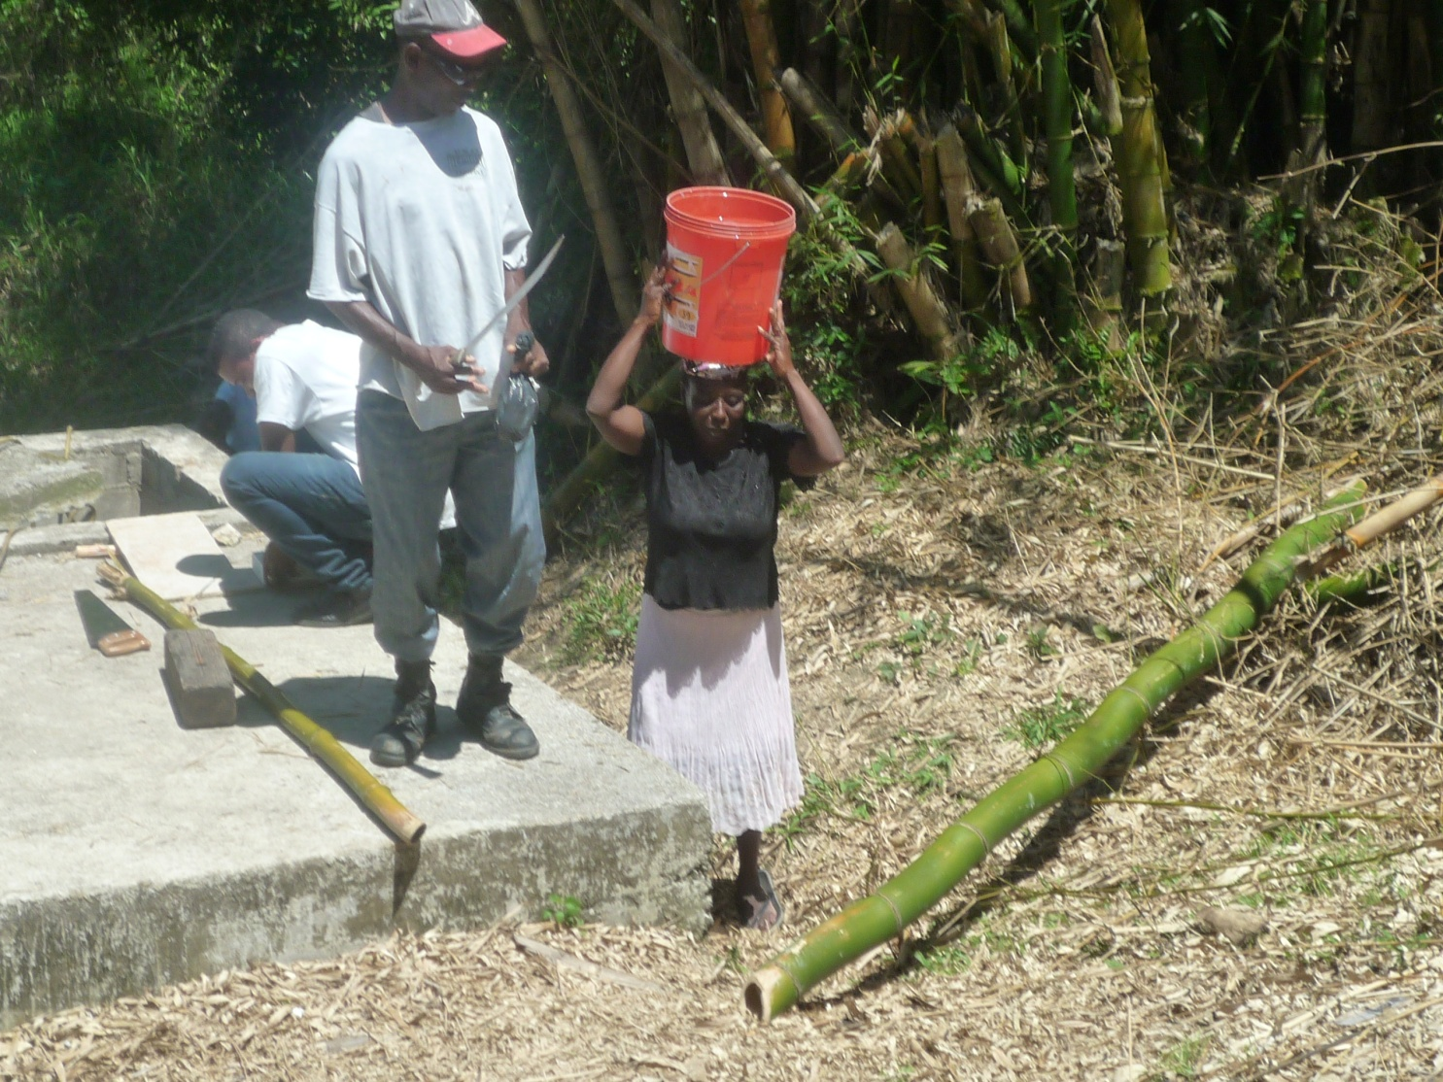
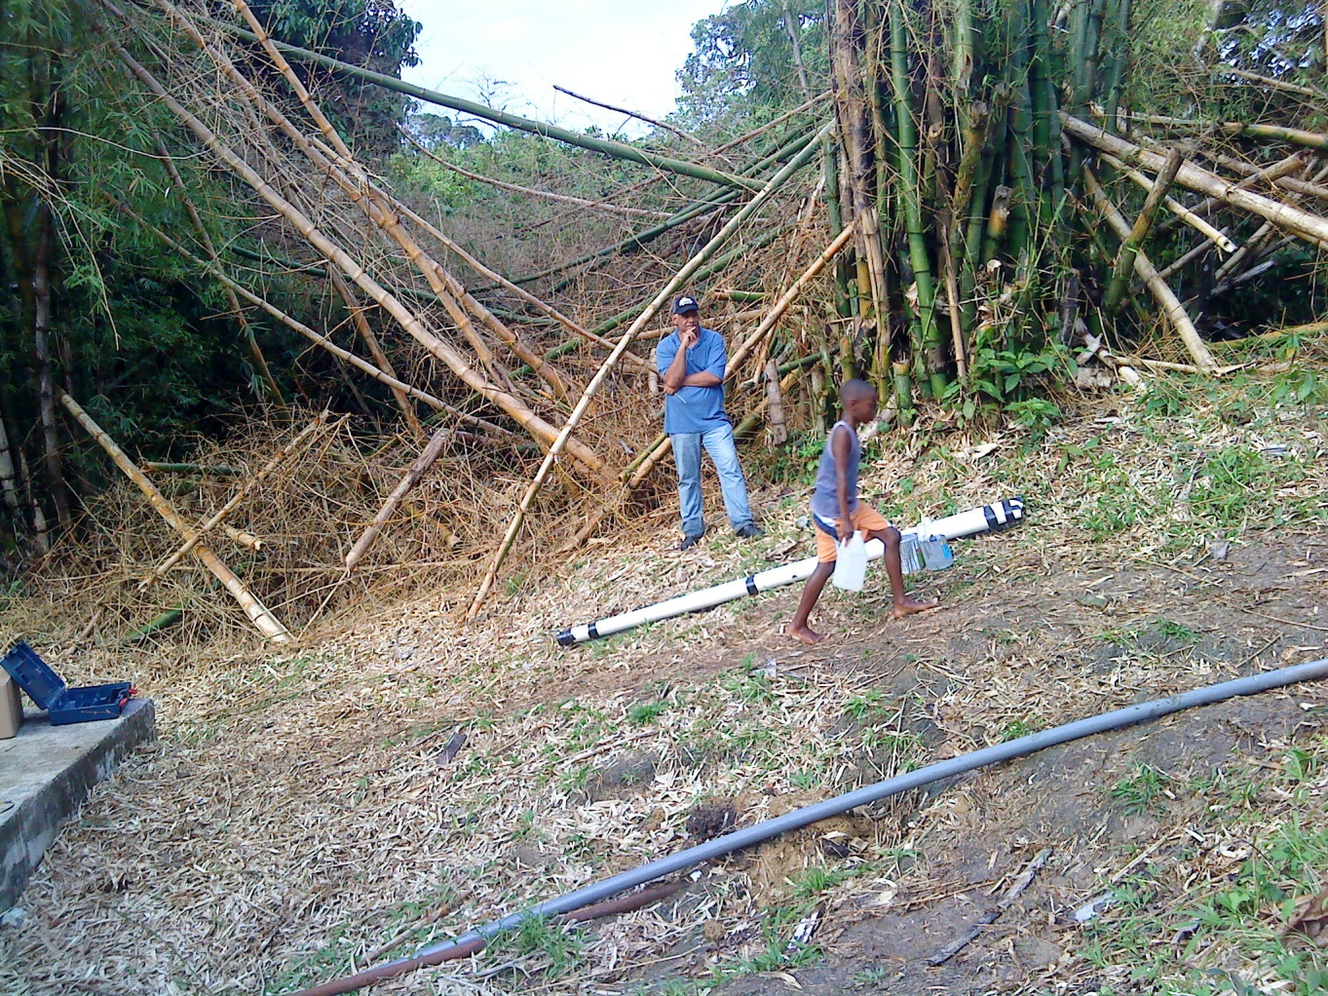
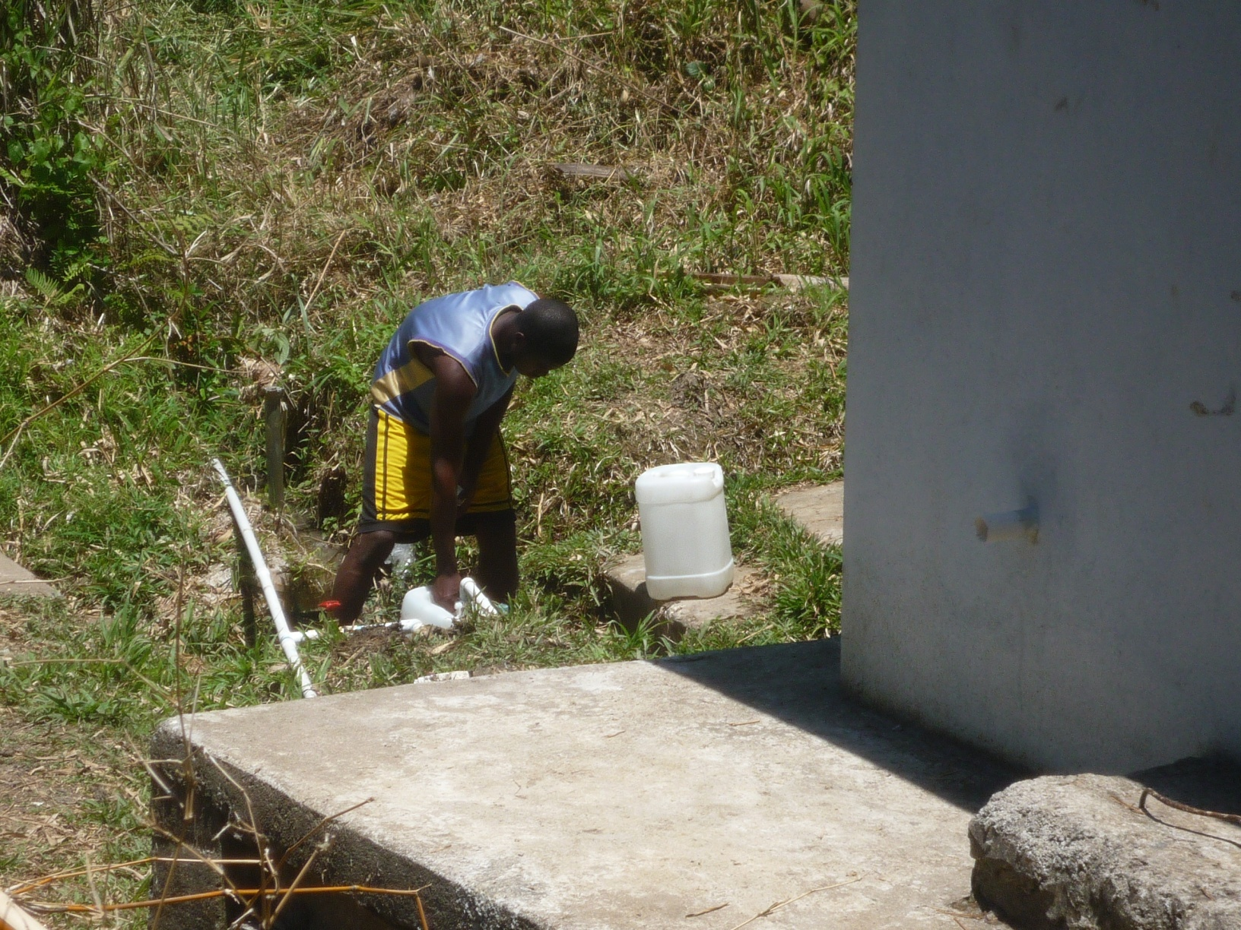
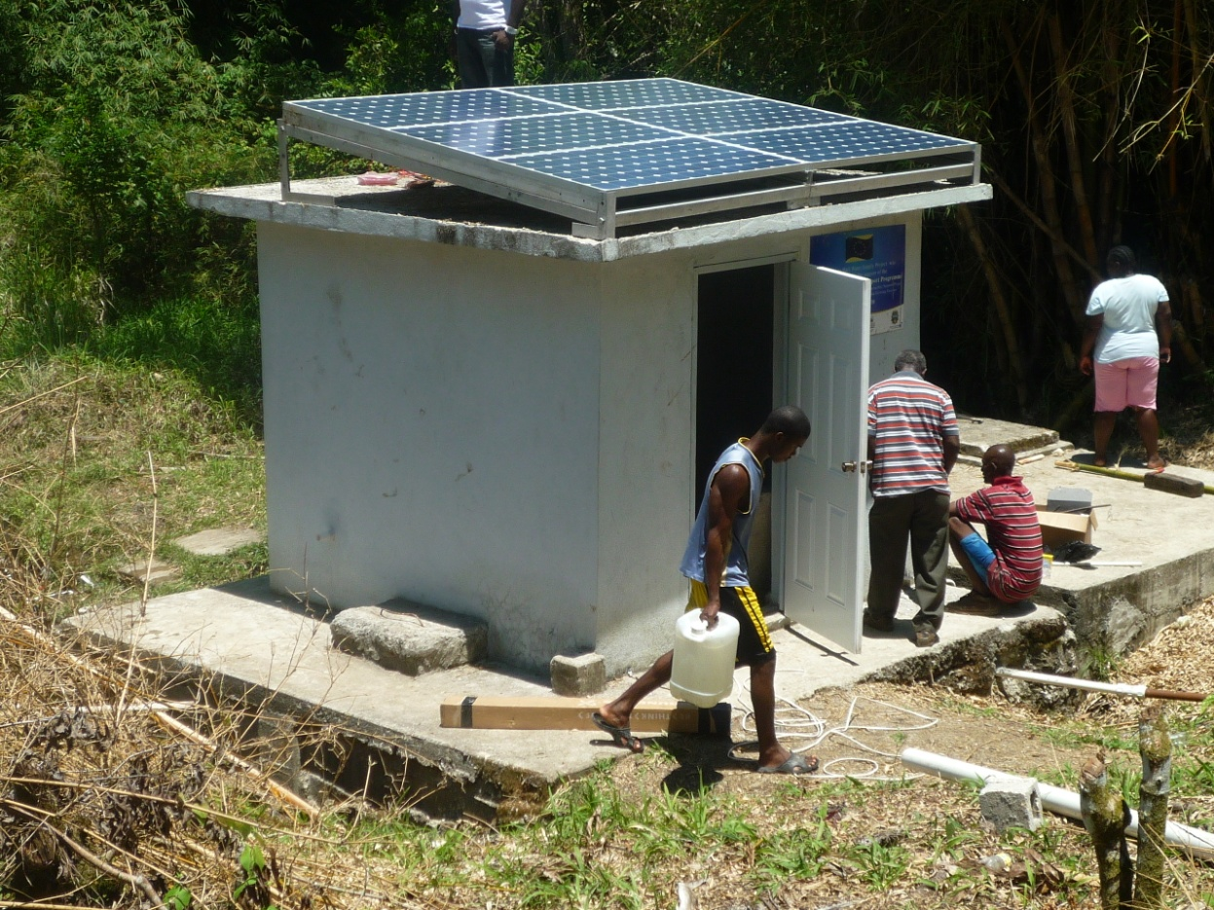
Residents Collect Water from ‘Gully’

Slide 4
Trek Up the slippery Slopes

Slide 5
Project Objective
Design, fabricate, install, test and commission a solar PV water pumping system to serve the Carron Hall community.
The system will be designed to pump 6000 gallons of water per day through a static head of 170 feet, over a distance of over 2000 feet, from the intake tank to the point of storage at the Carron Hall Primary School.

Slide 6
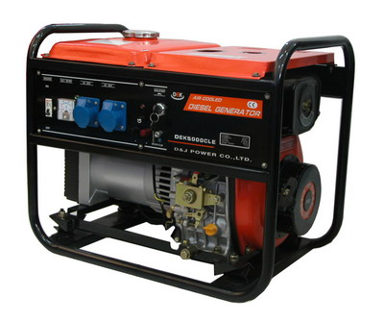
Alternatives
WIND
Wind Profile
Threshold Speed
Maintenance
Capital Cost
Operating Cost
SOLAR
Renewable
No Noise
Low Maintenance
No Pollution
Low Operating Cost
Modular
DIESEL
Non-Renewable
Noise Pollution
Maintenance
Pollution
Operating Cost

Slide 7
Advantages of Solar Systems
Solar System
Conventional Systems (oil)
Environmentally Friendly
Low Maintenance
No Moving Parts
No Noise
Modular
Emits harmful gases
Heavy maintenance required
Motors, boilers, chillers
Usually very noisy
Upsizing or Downsizing very difficult to attain

Slide 8
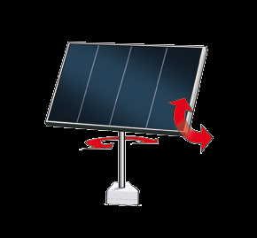
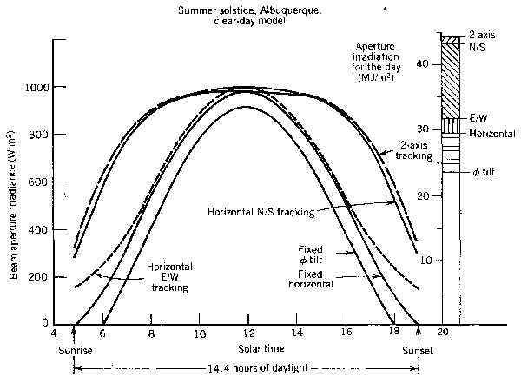
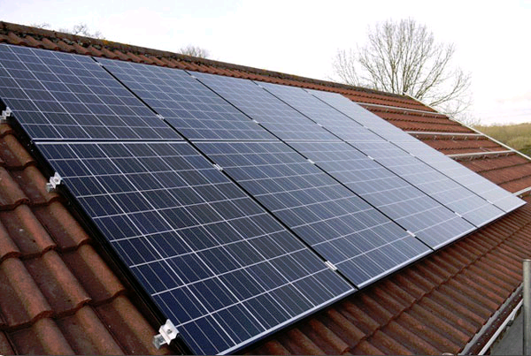
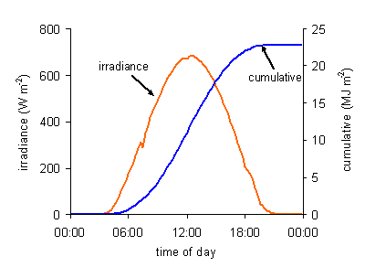
Generation Design Considerations
Tracking
VS
Fixed

Slide 9
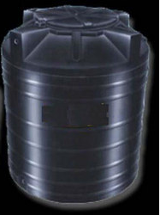
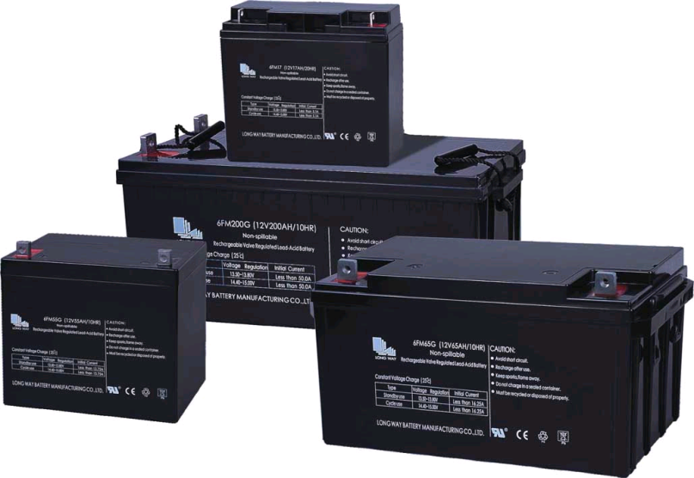
Storage Design Considerations
Deep Cycle Batteries – Cost Prohibitive
Water Tanks -Economical
VS
Extra Electrical Energy storage
Extra Water Storage

Slide 10
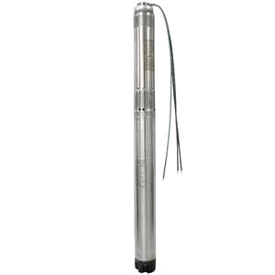
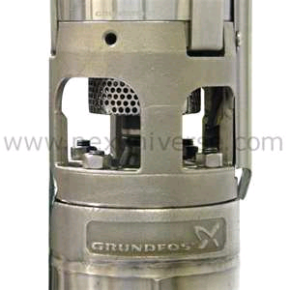
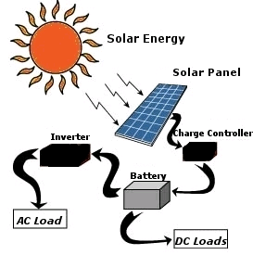
System Design Considerations
AC Pump/Inverter
DC Submersible Pump
VS
1 HP Grundfos submersible
DC Pump
11 gallons/min
300 ft Head

Slide 11
Scope of Works
UTech
NWC Carron Hall & Parish Council
Sourcing and Installing 1.0 kW of silicon solar panels
Sourcing and Installing submersible DC 1 HP Pump, pump motor and controller
Fabrication of rack for PV array to be seated
Design and install all electrical and plumbing works to ensure smooth operation of the pump
Provide an outlet from the pump to be connected to the piping from the tanks at the school
Install Electrical Controls for safe operation of Submersible Pump
Cleaning and brush cutting site
Sourcing and installing storage tanks at the school
Running water pipeline from the Pump to storage tanks at the school 2000 feet away
Stand pipe purchase and installation
Security arrangements from theft for any part of the system

Slide 12
Standard Testing Conditions (STC)
PV Quality begins with STC
Irradiance - 1000W/m²
Cell Temperature - 25±2°C
Spectral Distribution - AM1.5
PV Modules are Rated at STC
Fill Factor (FF) Measurements are standardized at STC
Zenith
48.19°(AM 1.5)
37°
n
Sun
Horizon
Tilted Surface

Slide 13
PV Module Specifications 6x180 Watt Mono Silicon Modules
Isc
Knee of Curve or maximum power point
Imp
Current
(Amps)
PV mono silicon Modules
RATING AT STC
(1kW/m², 25°C, 1.5 AM)
Open Circuit Voltage (Voc): 29.6 V
Maximum Power Voltage :23.8 V
Short Circuit Current (Isc): 8.40 A
Maximum Power Current :7.57 A
Module Efficiency (%):13.6%
Power Curve
Voltage (Volts)
Vmp
Voc

Slide 14
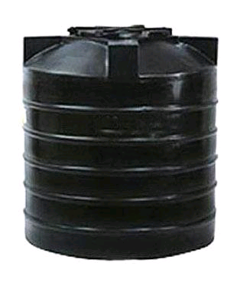
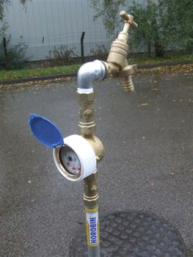
System Schematics Final Design
6x180 W PV Modules
1x1HP DC Submersible Pump
6000 gallons Water storage at school
Cut off sensor switch 6” above Pump
Cut off sensor switch at school tanks

Slide 15
Project Cost – Local Component
Item | Local Material/Equipment Costing | Quantity | Unit Cost (JA$) | Total Cost
1 | Electrical Contractor Material (Isolators switches panel boxes wires clips etc) Labour and Supervision | 1 |  | 14 000.00 42 000.00
2 | Grillwork Contractor (Carron Hall) Fabricate crib for PV Array to specifications and weld to pole | 1 |  | 60 000.00
3 | Mason/Carpenter (Carron Hall) Prepare footing cast concrete and install pole above surface of tanks for support of PV array | 1 |  | 45 000.00
4 | Plumbing Contractor (Carron Hall) Connecting pump outlet to main piping and to tanks & misc. | 1 |  | 11 000.00
5 | Labour Force (Carron Hall) Foreman/supervisor Water Women/Cooks Cutlass Brushmen Casual Labourers | 1 2 4 2 | 8 days x3600.00 8 days x2000.00 3 days x2200.00 8 days x1800.00 | 28 800.00 32 000.00 26 400.00 28 800.00
6 | Miscellaneous expenditure @ 10% | 1 |  | 28 800.00
7 | Accommodation for Engineer | 1 | 8x5000.00 | 40 000.00
8 | Design and Project Management |  |  | 300 000.00
 | Project Sub Total (JA$) |  |  | 656 800.00

Slide 16
Project Cost – Oversees Component
Item | Oversees Material/Equipment Costing | Quantity | Unit Cost ($) | Total Cost
1 | 180 Watt (peak) Mono-silicon PV Module | 6 | USD 900 | US$5400.00
2 | 1HP Submersible DC Pump Assembly with Pump Controller | 1 | USD 4200 | US$4200.00
3 | Project Sub Total (USD) |  |  | US$ 9600.00
Project Sub Total (JA$) | 656 800.00
Project Total (JA$) | JA$1482400.00

Slide 17
Project Schedule
 |  |  |  | Gantt Chart
 |  | Carron Hall Solar Water Pumping Project
Item No. | Activity | Week 0 | Week 1 |  | Week 2 |  | Week 3 |  | Week 4 |  | Week 5
1 | Design Solar System
2 | Import Panels & Pump Assembly
3 | Brush Cut Site
4 | Fabricate PV Rack
5 | Install PV Array
6 | Connect Pump & Controller
7 | Test and Commission

Slide 18
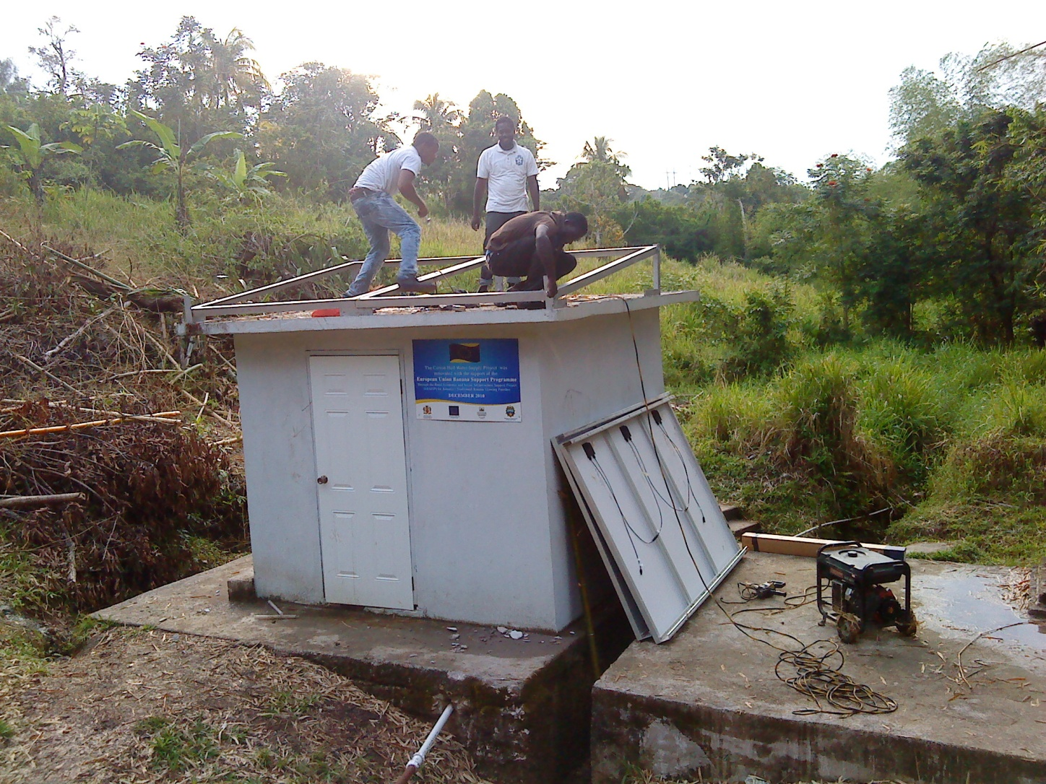
Onsite Installation Begins

Slide 19
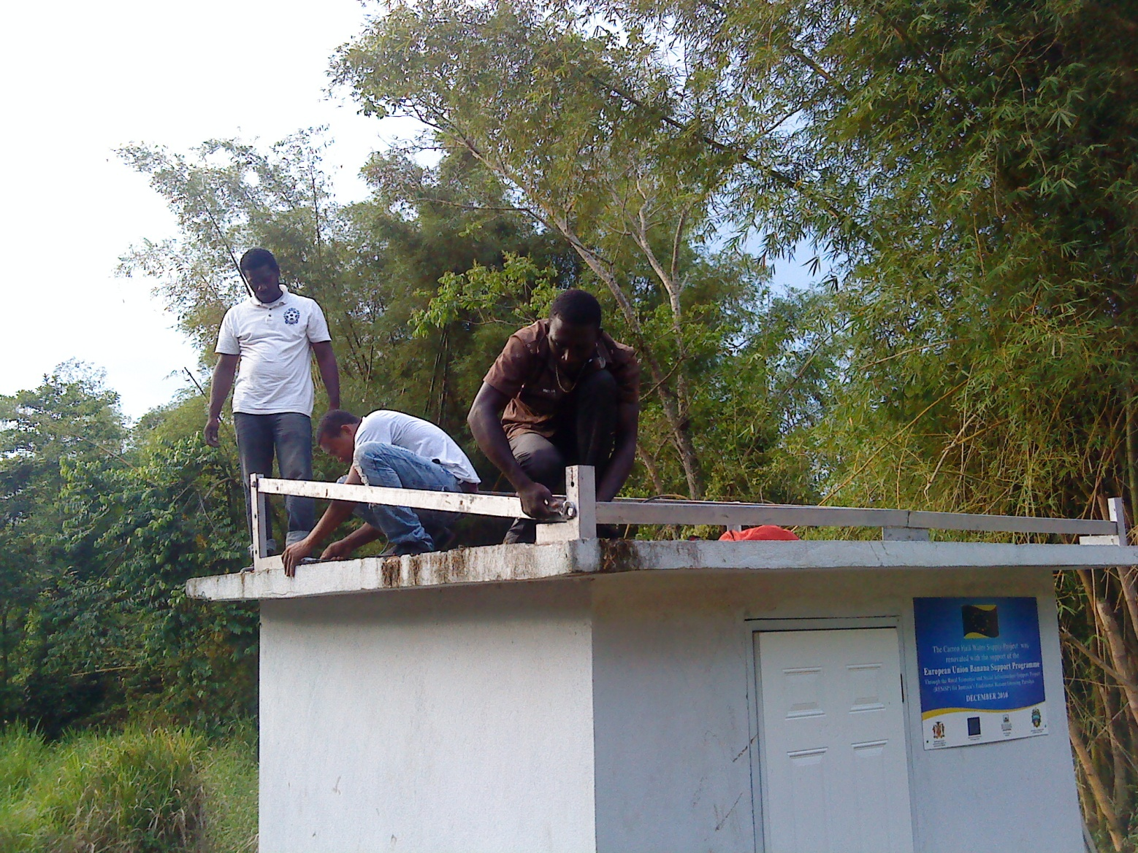
Crib for PV Array of 6 x 180 W Mono Silicon Modules

Slide 20
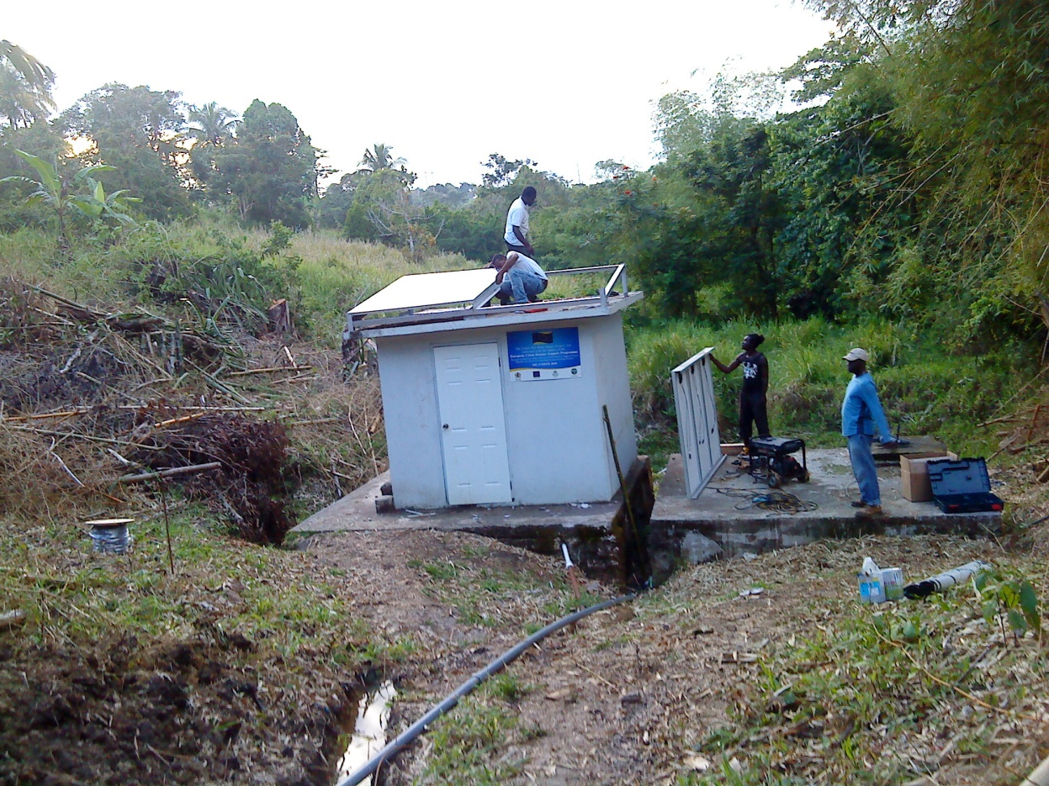
Installation in Sections

Slide 21
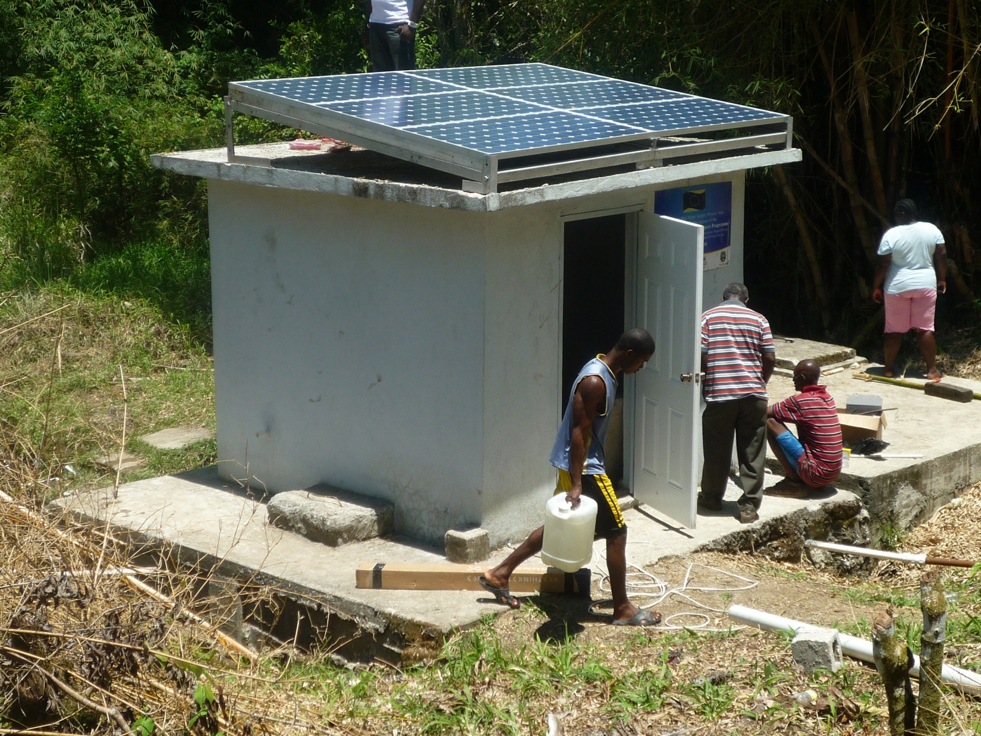
Complete PV Installation

Slide 22
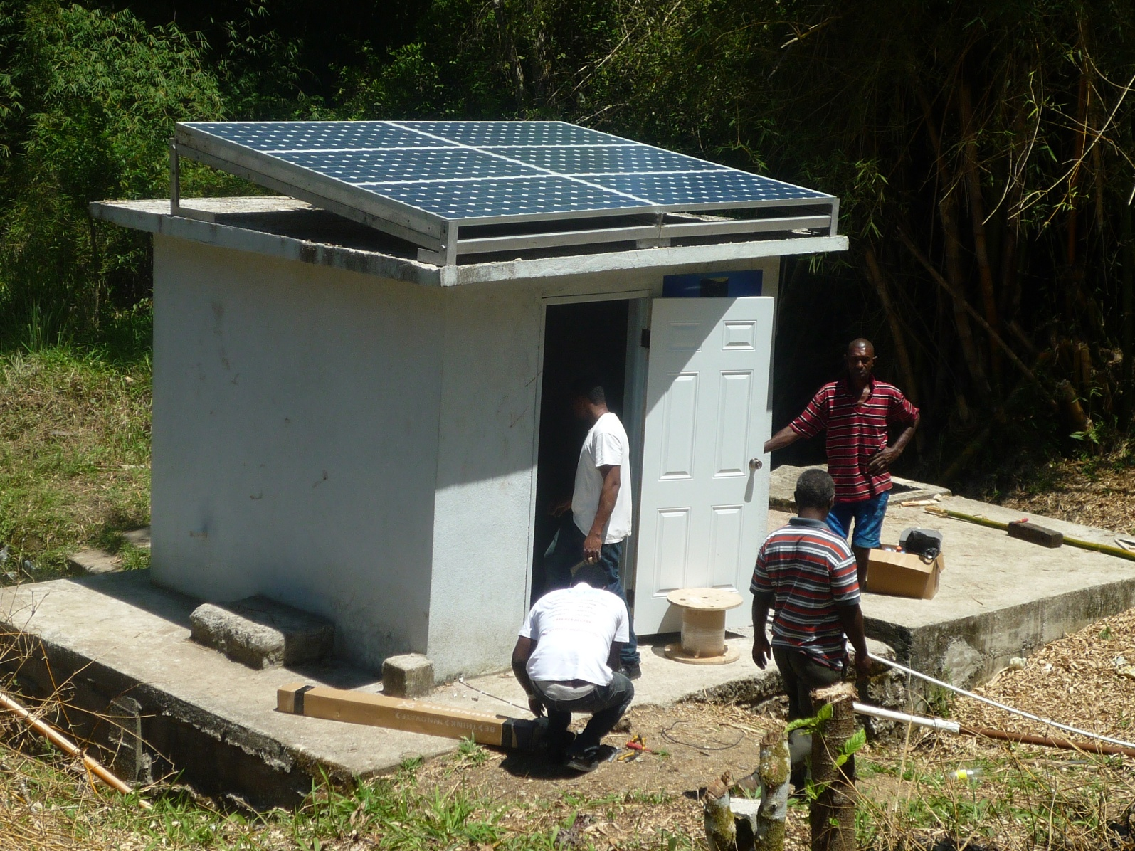
Submersible Pump inside pump house

Slide 23
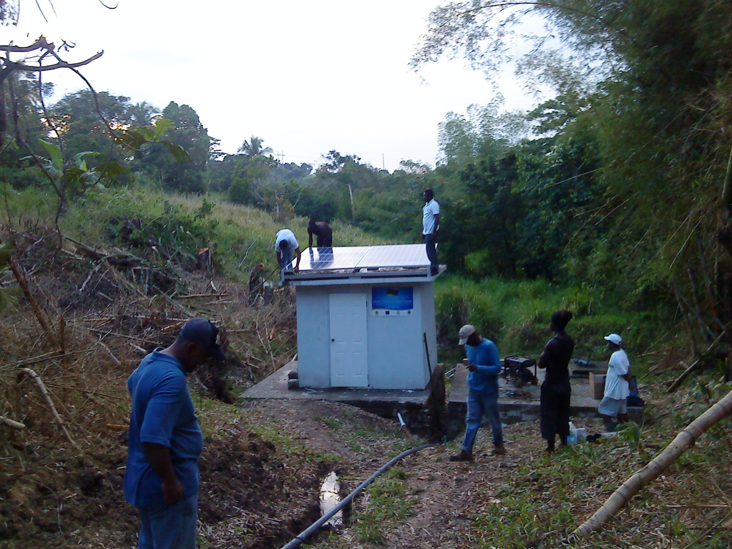
View from the Slope

Slide 24
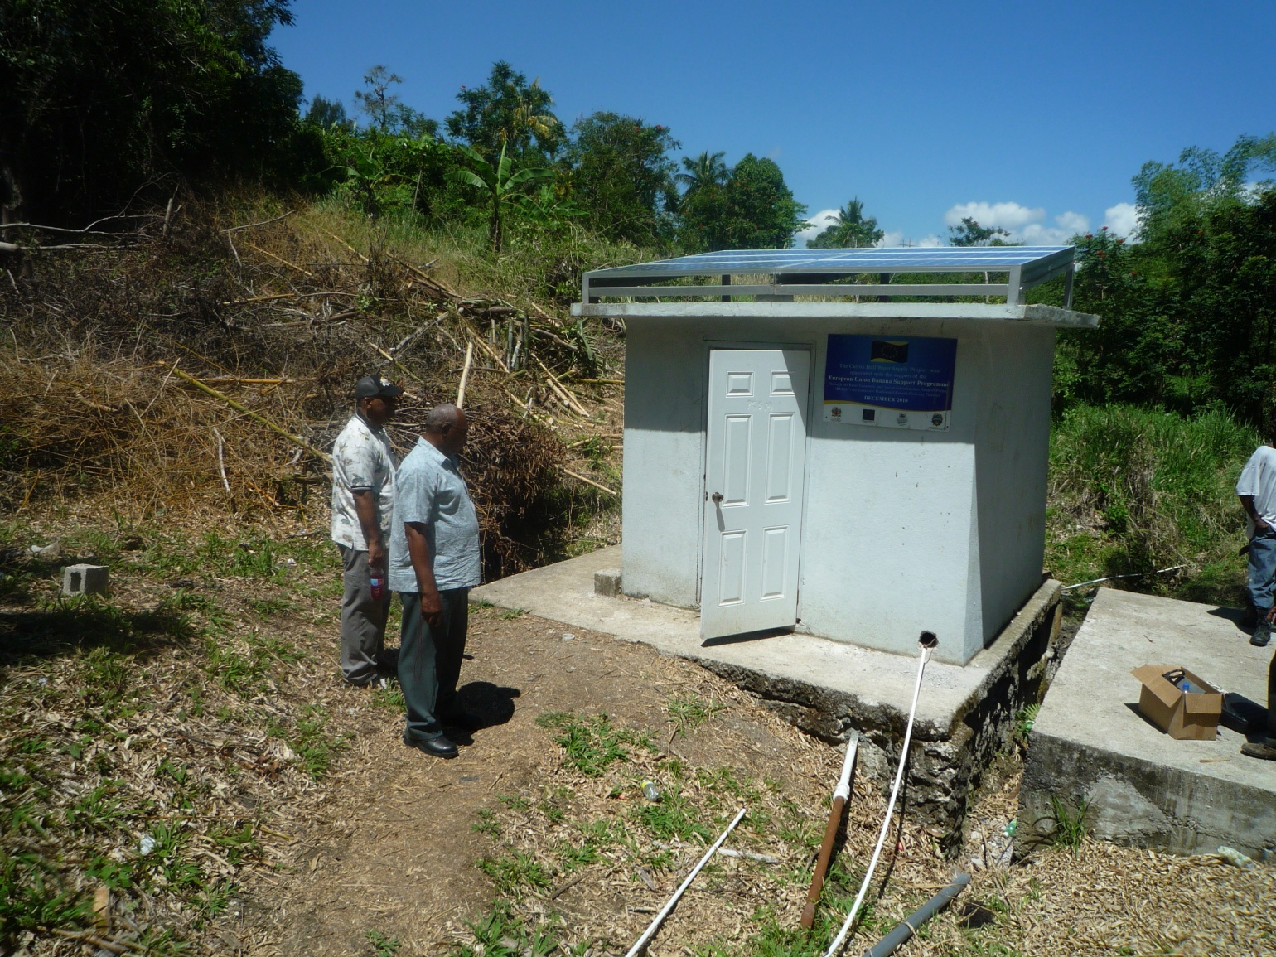
Inspection

Slide 25
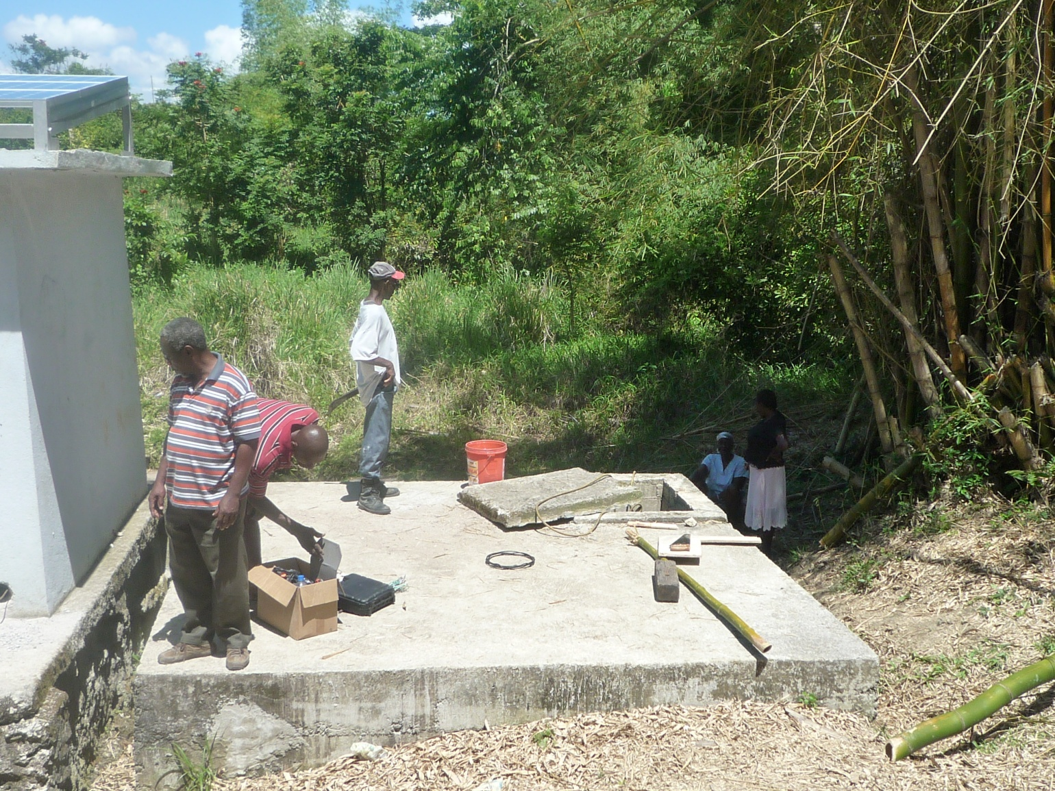
Two Underground Tanks 3000 gals each

Slide 26
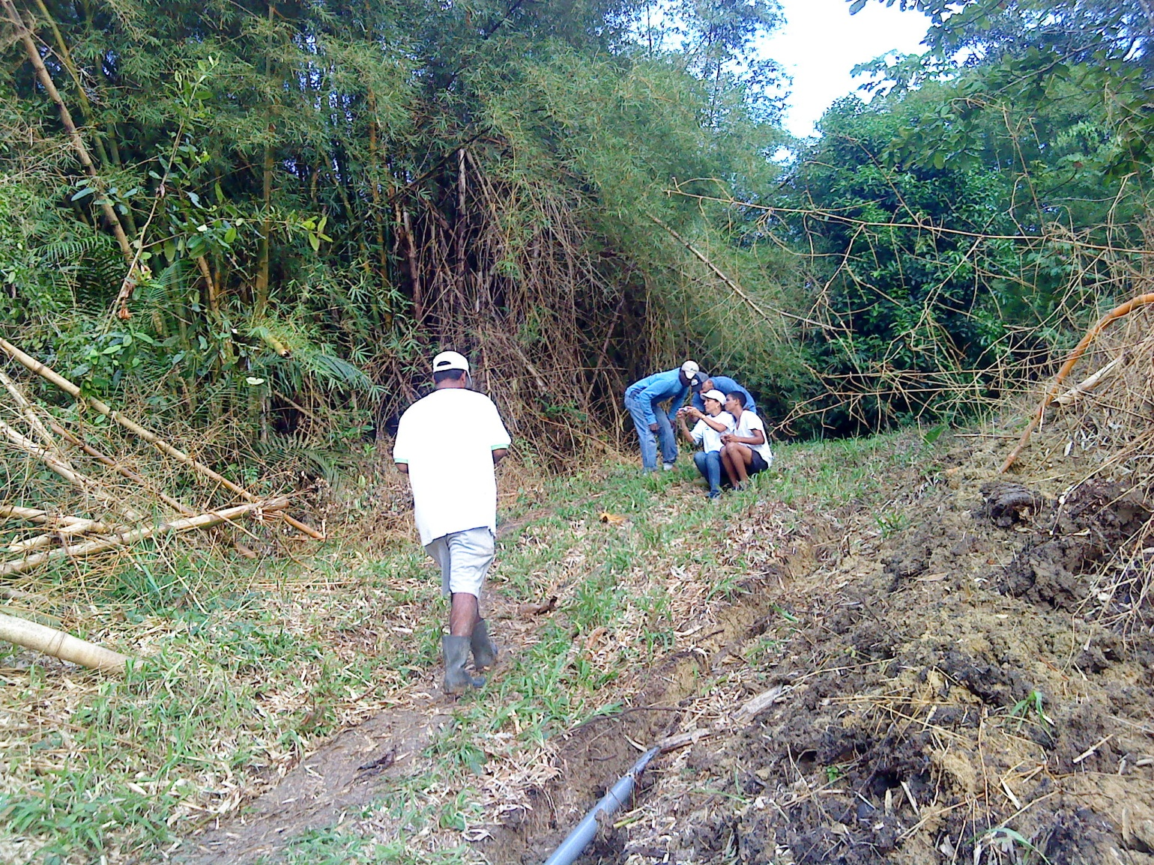
2 Inch pipe carrying water 2000 feet to tanks at Primary school

Slide 27
Completed System in Operation
6x180 W PV Modules
1x1HP DC Submersible Pump
6000 gallons Water storage at school
Cut off sensor switch 6” above Pump
Cut off sensor switch at school tanks

Slide 28
Project Benefits
Running water promotes good sanitation for the community
Reduction of environmental pollution and the preservation of clean air in rural Jamaica through the use of environmentally friendly technology
Increase use of this technology will bring about a nationwide awareness of the benefits of using this kind of energy
Increase the net worth of the community and stimulate community pride
Provide employment to residence of the community in Renewable Energy Technology
Increase Jamaica’s Carbon Credits by not using fossil fuel according to the Kyoto Protocol.

Slide 29
Project Economic and Environmental Analysis
Pay Back Period
19 months
Benefit Cost Ratio
3.75:1
Environmental
Carbon Credits
40 Tons of Environmentally Unfriendly Emissions prevented over system lifetime

Slide 30
Handing Over Ceremony

Slide 31
Concluding Remarks
The project was fully funded by a few local charities
The solar pump installed was a submersible 1 horse power pump designed to lift 11 gallons of water per minute to a height of 300 feet. This pump was sourced, imported and installed on site.
The essential features of the system are as follows:
Six 180 Watt solar PV modules were arranged in a series-parallel connection. On a sunny day this array supply approximately 1 kW of power to the system
This power is transmitted to the submersible 1 hp (746W) pump which them powers the water across a distance of 2000 feet and a head of 200 feet.
Two cut- off sensor switches were installed on the system
One switch was located 6 inches above the submersed pump to ensure that the pump never operates unless it is fully submersed below water.
The second switch was installed on the tanks at the local school 1700 feet away. It ensures that when the tanks are full the switch cuts off the pump.

Slide 32
Concluding Remarks Cont’d
2000 feet of 2 inches PVC pipes were installed between the sump and the tank to facilitate the flow of water.
From the tanks the water is gravity fed into the community by means of three stand pipes strategically located to facilitate all the residents, and the basic and Primary schools.
The building that houses the pump also serves as a control room for the PV array and the pump
The system operates without storage batteries. The only storage used are the water tanks (6000 gallons) at the elementary school
The system is virtually maintenance free, and as long as the community cares for and prevents larceny and vandalism, the system should have a life of over 25 years.

Slide 33
Acknowledgements
Minister Bobby Montague
St. Mary Parish Council
Citizens of Carron Hall (Bwoyo, Natalie, Mirander)
Carron Hall Community Council
Carron Hall Primary School Board
UTech School of Engineering
Mrs. Charmaine Delisser – Dean
Dr. Noel Brown, Dr. Earle Wilson, Mr. Noel Sinclair
NWC
UUC Solar

Slide 34
THANK YOU - For your time and attention -
Questions/Comments ?

